Slide 1

ANALyZING US ACCIDENTS AND THEIR RELATED FACTORS DATA ANALYSIS PROJECT
Kratika Sharma

Slide 2

AGENDA
Introduction – Defining Facts
Data Methodology
Conclusion and Future Scope
Exploratory Data Analysis
Data Modelling

Slide 3

INTRODUCTION

Slide 4
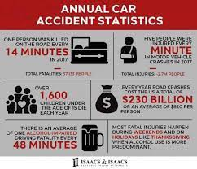
ROAD ACCIDENTS IN USA – DEFINING FACTS
The United States is one of the busiest countries in terms of road traffic with nearly 280 million vehicles in operation and more than 227.5 million drivers holding a valid driving license. Road accidents have become very common these days. In the USA, over 40k people die in road accidents each year, and 3 million get injured. Road crashes cost the country around $230 billion per year or an average of $ 822 per person

Slide 5

Data AnD METHODOLOGY

Slide 6
DATA COLLECTION
For our analysis, we selected the US Accidents data from February 2016 to December 2020 from Kaggle.
ABOUT THE DATASET :
The dataset contains data of all the accidents in 49 states of the US. The data is collected using multiple API’s that provide streaming traffic incident data. It has 47 variables and 1048576 observations. We have information about each observation which include the place of the accident, the time of the accident, the temperature at the place, the humidity of the place, the severity of the accident, the time of the day, the wind speed, the weather prediction for that day and many more.
We have picked this data as it has almost all type of data such as time, date, numerical values, strings, floating type integers, Boolean values etc. and we wanted to experiment and learn data analysis on datasets which are much like those in the real world. The size of the dataset is also huge, and it might give us an opportunity to dive deep into the data and understand the basic concepts of data analysis in a much better way.

Slide 7
WHY THIS DATASET? OUR MOTIVATION BEHIND CHOOSING IT.
The purpose of our analysis is to explore some of the factors that contribute to road accidents in the US. The number of fatal and disabling road accidents increases daily and is a real challenge for all to prevent. Awareness creation, strict implementation of traffic rules, and scientific engineering measures are the need of the hour to avoid this catastrophe
To do the same, it is of utmost importance that we as people understand the trends and patterns of the accidents taking place in the country, and to do the same, analysis of the available data has to be carried out. Throughout our project, we have kept in mind the need of giving concrete answers to important questions and finding a correlation between factors that would help the concerned authorities to prevent these accidents
To identify the parameters that affect the most for predicting the severity of an accident and to identify the main features that can be controlled to reduce the number of accidents or to decrease the level of severity

Slide 8
DATA CLEANING
We used different functions in Python and its associated libraries to clean our data. The data consists of 47 columns and 1,048,576 rows. Below are the steps we undertook to clean our data :
Finding Null Values – Since the data is quite large, we suspected the presence of null/missing values and checked the same using the “isna” function.
Data can have missing values for several reasons such as observations that were not recorded and data corruption. From the results of the function, we observed that out of 47 columns, 19 columns had null values.
Out of these 19 columns, some were numeric. There are multiple ways to remove these null values: backfilling, forward filling, checking for outliers and then deciding to change it with mean or median, etc. According to ways of data manipulation, these values can be replaced by the median or mean of the observations/maximum or minimum value or zero value. But the approach of replacing these values for each column can be different depending on the nature of the data. We looked at the box plots of these and according to the outliers present we replaced null values in numeric columns with median or mean.
Some columns were of string data type. We applied our professional judgment and statistical theory to replace the values for each of the columns as explained in the following slides.
We further merged few Boolean columns and decided to drop certain columns which were not needed.

Slide 9

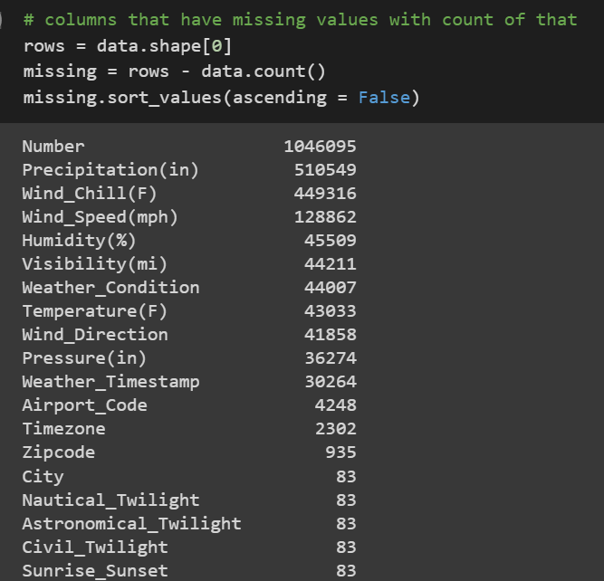
Columns with Null values:

Slide 10
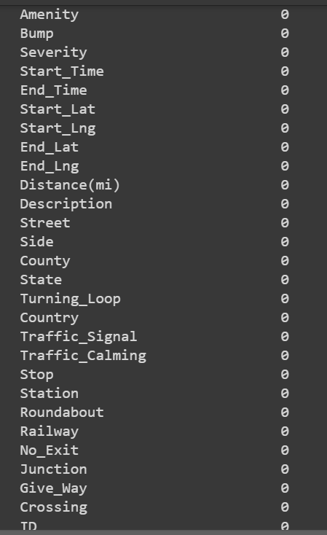
Columns with Non-Null values:

Slide 11
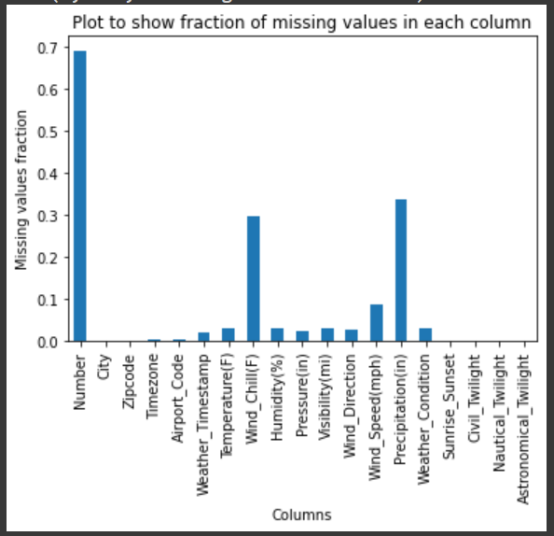
Plot to show the fraction of missing values in each column

Slide 12
How did we tackle numeric missing values?
To clean numeric columns like Wind Speed, Humidity, Visibility, Temperature and Pressure, below steps were used:
Check number of null values.
Compute mean, median, max, min, and mode of the column.
Create a box plot of the column and check for outliers.
If outliers were found, replace null values with median. If no outlier found, replace null values with the mean.
An example is shown in next slide for Wind_Speed. Similarly, all other numeric columns were taken care of.

Slide 13
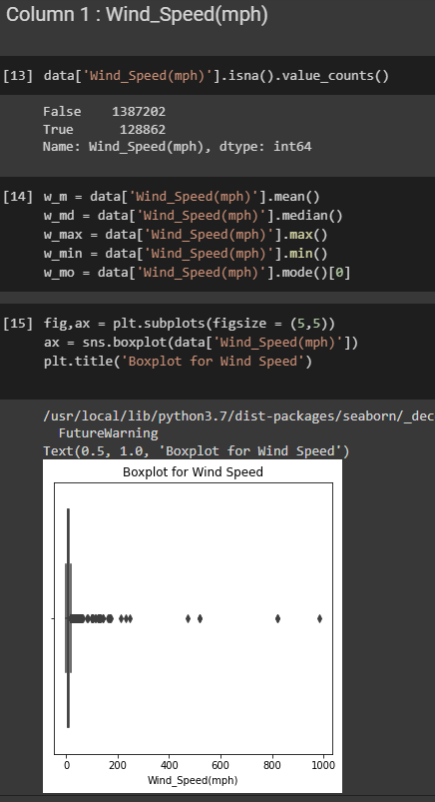
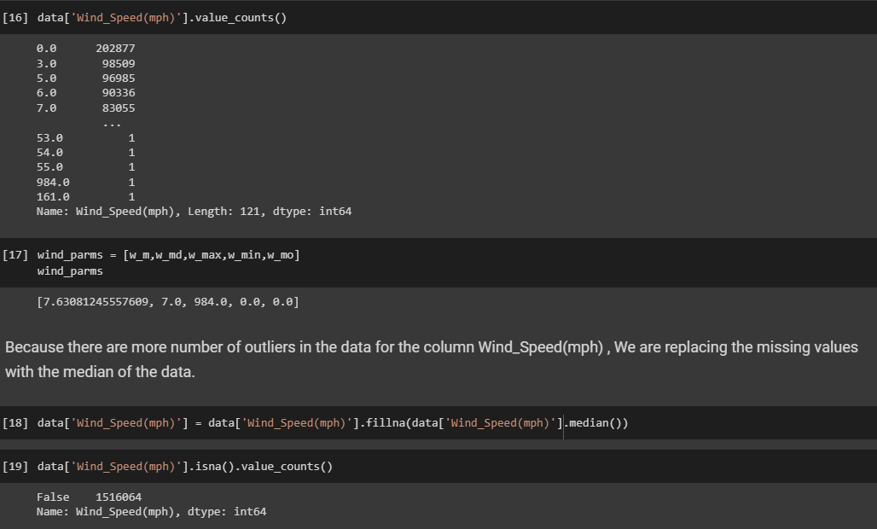
Code Snippet for Numeric Column: Wind_Speed

Slide 14
How did we tackle missing values in String columns?
To clean string columns, different strategies were employed. Let's peek into those columns.

Slide 15
Columns: Wind Direction and Weather Condition
For columns like Wind Direction and Weather Condition, below steps were taken:
It was observed some values in these columns are repeatedly written in different ways (case). Like CALM and Calm, North and N, etc. in column Wind Direction.
To maintain uniformity in data, we used the 'replace' function and replaced Calm with CALM, North with N, etc.
Further, missing values were calculated and looking at the number of non-null values, we divided the missing number among all the non-null values by using fraction of the count of non-null values, as per below formula:
data['Wind_Direction'].value_counts()/len(data['Wind_Direction'])*missing['Wind_Direction']).round(0)
We kept dividing these null values , till all the null values were replaced by non-null values.

Slide 16
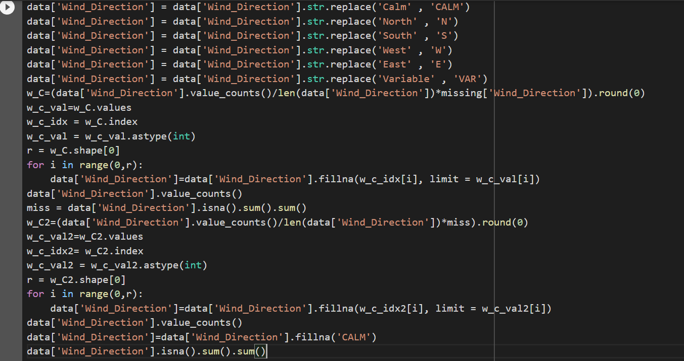
Code snippet for cleaning of column: Wind Direction

Slide 17
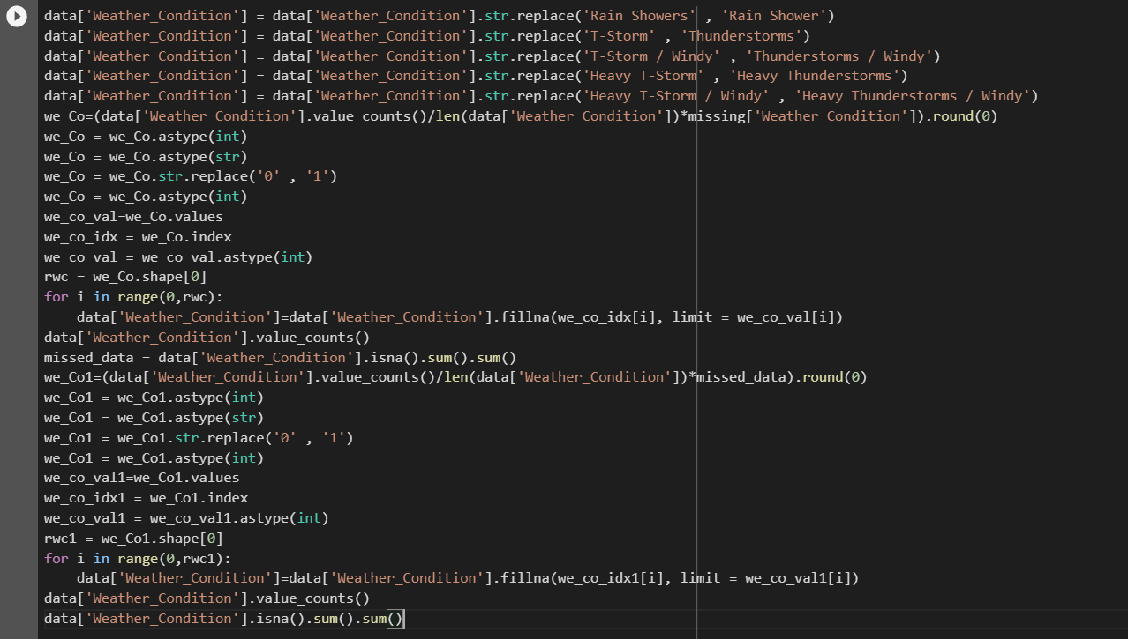
Code snippet for cleaning of column: Weather Condition

Slide 18
Columns: City and Time zone
The null values in the columns like City and Time zone were cleared by using below steps:
City:
We tried to see the correlation between the column 'City' and every other column which has zero null values
After multiple hit and trials, we found that column 'County' is a best fit for consideration
Each County has multiple City in it
We created a Data Frame which has all the null 'City' and corresponding 'County'
Since each 'County' has multiple 'City' in it, so, we found the 'City' with maximum number of accidents in each 'County' present in above created Data Frame
Finally, we replaced the null values in column 'City' with the 'City' with maximum number of accidents in each 'County' present in above created Data Frame
Time zone:
We tried to see the correlation between the column 'Timezone' and every other column which has zero null values
After multiple hit and trials, we found that column 'County' and 'City' were the best fit for consideration
Few County has multiple Time zones in it. Similarly, few City has multiple Time zone in it
Upon checking, it was found that there are some Cities in the data set which has no Time zone associated with them
But this was not the case with County. Every County has at least one associated Time zone in it
We created a Data Frame which has all the null 'Timezone' and corresponding 'County'
Since multiple 'County' has multiple 'Timezone' in it, so, we found the 'Timezone' with maximum number of accidents in each 'County' present in above created Data Frame
Finally, we replaced the null values in column 'Timezone' with the 'Timezone' with maximum number of accidents in each 'County' present in above created Data Frame

Slide 19
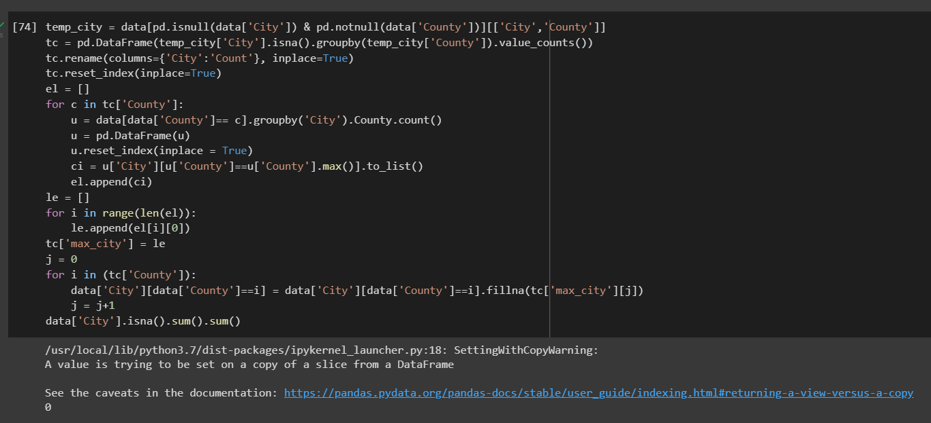
Code snippet for cleaning of column: City

Slide 20
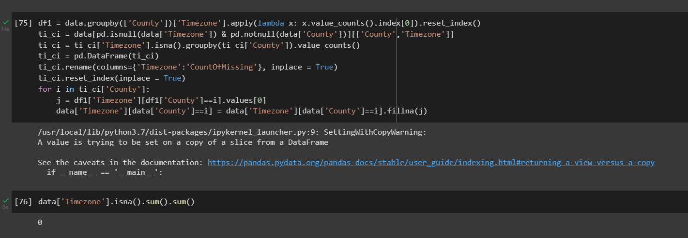
Code snippet for cleaning of column: Timezone

Slide 21
How did we tackle Boolean Columns?
There were multiple columns which were holding Boolean values: True and False. These columns were: Railway, Bump, Amenity, Crossing, Give_Way, Junction, No_Exit, Roundabout, Station, Stop, Traffic_Calming, Traffic_Signal, Turning_Loop
After analyzing data, it was found that if one column is True, the other columns were False
So, we created one column 'Location' which will hold the above Boolean column name which is True. Like it will hold Railway if of all the columns Railway has True value for that row

Slide 22
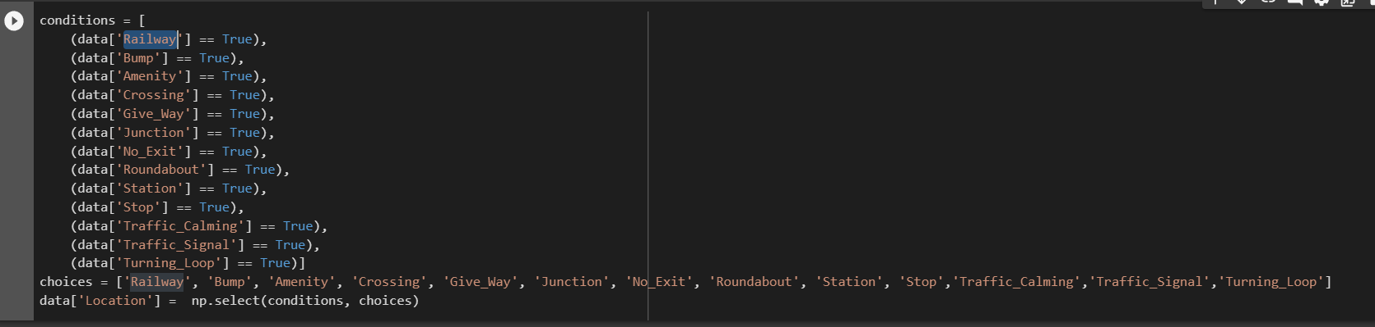
Code Snippet for Boolean Columns:

Slide 23
Dropping Certain Columns
After understanding the columns and their definitions we have decided to delete certain columns:
The columns Number, Precipitation, and Wind_Chill had most missing values(40-60% of the data). So, it was wise to remove those columns altogether.
Since this dataset was of United States only, so it made sense to drop column 'Country' as that possesses only one value which is United States
Airport Code : Retaining the Airport code of the region where the accidents occurred wasn’t very useful in our analysis. Since a city/county wise analysis is being carried out, the use of airport code would have been redundant and non-necessary.
Zip Code : As we already have City and County. Further filling zip code null values in relation to city and county was not possible as every county and city had multiple zip codes. And City already had null values. Further our analysis does not require Zipcode as we were mostly linking to City or County level
Astronomical_Twilight, Nautical_Twilight, and Civil_Twilight were not necessary for our analysis. So, we decided to drop those columns too
We were already fetching hour of day from Start_Date column so, we did not need Sunset_Sunrise for analysis
Final check on duplicate values was also done. Fortunately, there were no duplicate values found in the data

Slide 24
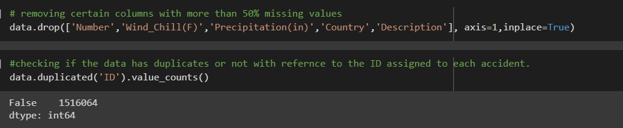
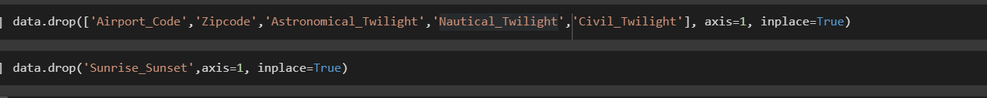
Code Snippet for Dropping Columns

Slide 25
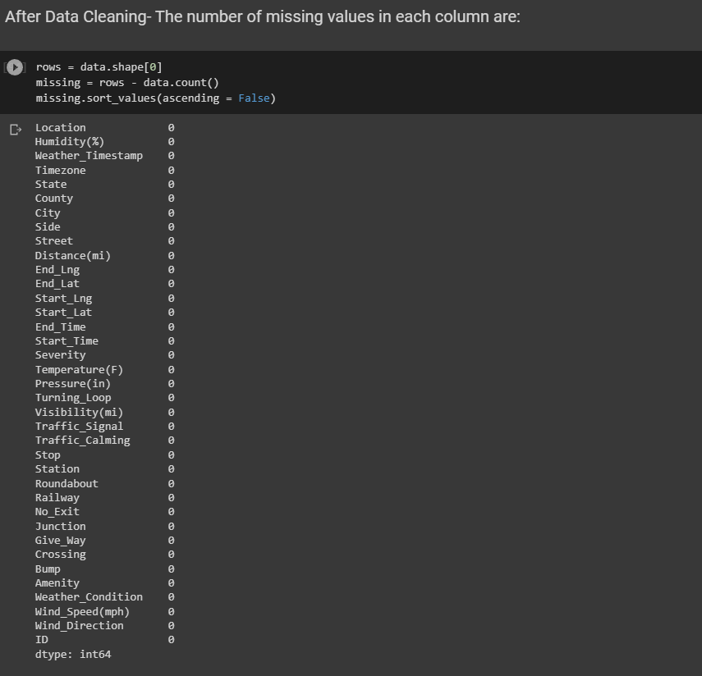
Post Data Cleaning

Slide 26

Answering the right questions to get meaningful data insights

Slide 27
Methods used to visualize the data
Method 1: We have used the .value_counts() to first count the values of each unique value in the column.
Method 2: We can group the data by a particular column, count total rows corresponding to each group and sort them in descending order using .groupby() , .count() , .sort_values(). This is useful when we must find values in a column with high occurring or low occurring accident.
Method 3: We have used methods to convert the timestamp field in date-time format using pd.to_datetime() and then fetched the hourly value of each row of the data by .dt.hour.
Method 4: To understand and visualize the data on a daily, monthly, and yearly manner we have adopted the in-built functions mentioned below :
To pull the day of the week from the timestamp format, we have used function [.dt.dayofweek == n], where n =0,1,2,3,4,5,6 for each day of the week
To pull the month of the year from the timestamp format we can use function like .dt.month
To pull the year from timestamp format we can use function [.dt.year == n], with n = 2016, 2018, etc.
Method 5: We have grouped the data by 'column1' and 'column2' using groupby(). We have further calculated number of accidents in each 'column2' grouped in'column1' by using .size(). Then again grouped by 'column1' using groupby(level=0) to deal with multilevel index and then used .idxmax() to get 'column2' with maximum number of accidents in each 'column1' .
We have visualized the data with respect to 2 different columns with the help of the groupby() method and have used additional functions such as
.count()/.size()- to get the count of a particular column after grouping the data on another column.
.idxmax()- to get the highest value of one column while grouping the data on another column.
.apply() - to pass columns as series to the function
Method 6: We have also used the .mean(), .median() functions to get the data for certain columns after appropriate grouping of the data.

Slide 28
Types of plots used to visualize the data.
We have used both the matplotlib and the seaborn libraries to get appropriate graphs based on the visualizations required for our dataset.
Graphs used from the Matplotlib library:
Bar graph: We have used both the horizontal bar graph(.barh()) and the traditional bar graph(.plot(kind='bar')) wherever required.
Pie chart: We have used the pie chart (.plot(kind='pie')) for columns that have Categorical values to understand what percentage of the data was recorded under those unique values in that column.
Scatter plot: We have used the scatterplot (.scatter()) to understand the trend of the data from left to right related to two columns to depict the nature of their relationship – Positive or Negative.
Graphs used from the Seaborn library:
Histplot: We have used the histogram plot (.histplot()) to interpret the nature of the graph – Symmetric, Skewed Right or Skewed Left.
Distplot: We have used the distribution plot(.distplot()) to depict the variation of the overall data distribution.

Slide 29
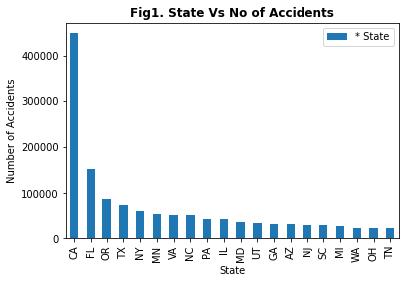
Which state has recorded the highest number of accidents?
The highest number of accidents were recorded in the state of California.
METHOD AND LOGIC BEHIND THE CODE :
To get the highest number of accidents in each state we have used method 1 where we plotted a bar graph after grouping the data by state.
TYPE OF PLOT :
.plot.bar() from the matplotlib library

Slide 30
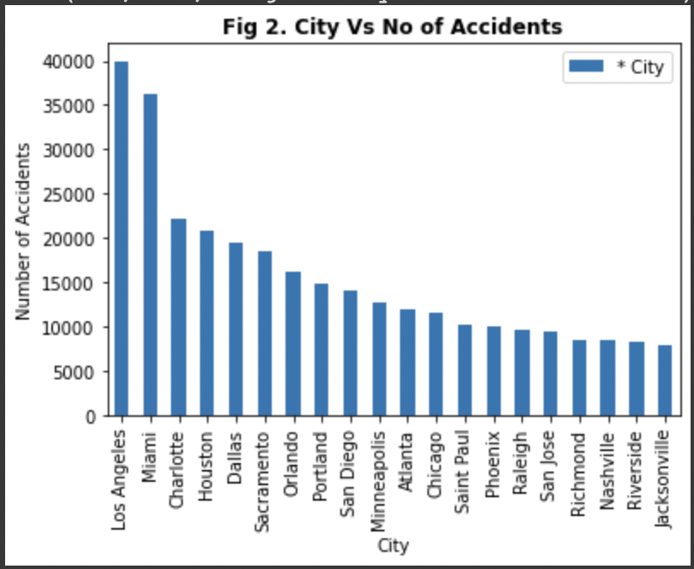
Which city has recorded the highest number of accidents?
There are many cities like California (LA, Sacramento, San Diego, Riverside, Jacksonville), Texas (Houston, Dallas, Austin), Florida (Miami, Orlando) and North Carolina (Charlotte, Raleigh). This is in tandem with the top three states: California, Florida, Texas, and North Carolina.
METHOD AND LOGIC BEHIND THE CODE :
Like the previous graph, we have applied Method 1, we have used "data.columnname.value_counts()[:20].plot(kind = 'bar')" to first count the value of unique value in the column and plot a bar graph showing first 20 highest occurring values.
TYPE OF PLOT :
.plot.bar() from the matplotlib library

Slide 31
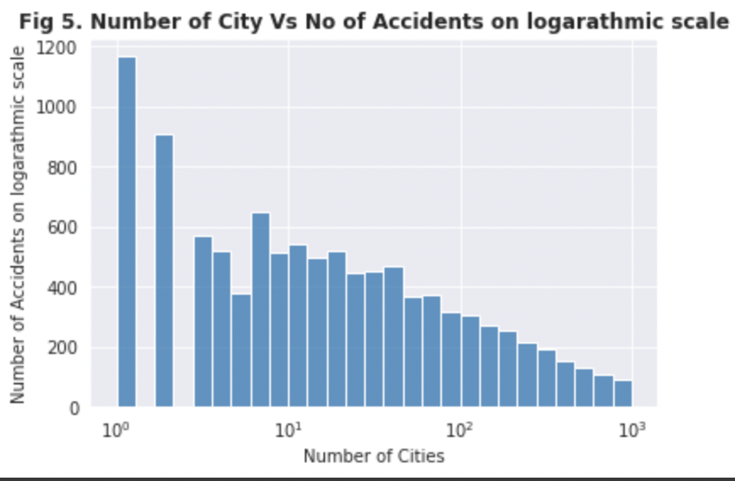
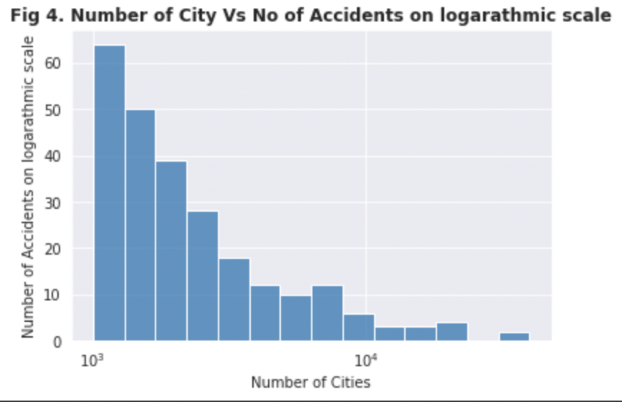
Number of Cities: Insights after an in-depth analysis - logarithmic scale
Graph depicting the number of cities which have recorded greater than 70 accidents
Graph depicting the number of cities which have recorded fewer than 70 accidents

Slide 32
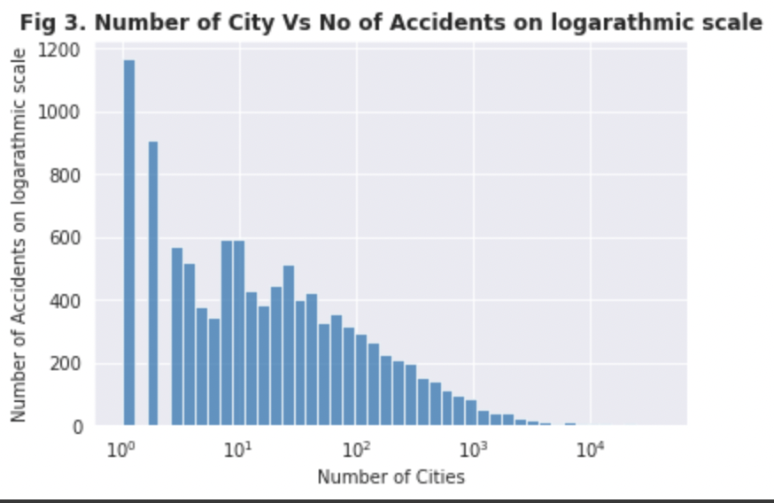
logarithmic scale, continued
Less than 70 cities (out of 10658) reported more than 1000 accidents during the period
Over 1000 cities have had just one accident in 4years- needs further investigation
Most of them have witnessed between 10–100 accidents during the period
Accidents by cities follow an exponentially decreasing distribution
2.35% of the total number of cities have an accident number greater than 1000.

Slide 33
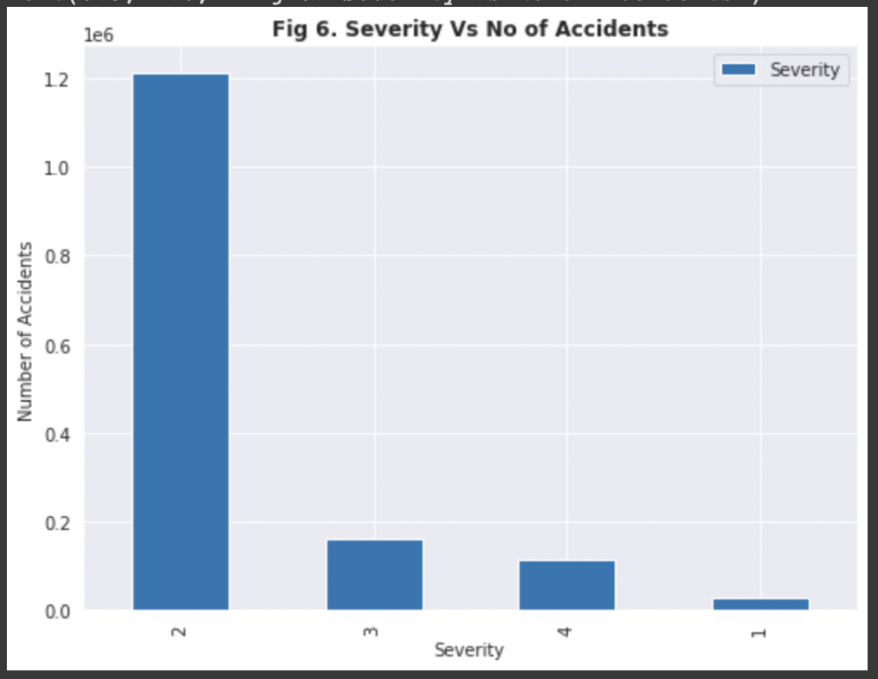
What is the level of severity that has been recorded the most?
The plot depicts that mostly the accidents had severity equal to 2(average) followed by 3 (above average). There are hardly any accidents with very low severity(0 and 1).
METHOD AND LOGIC BEHIND THE CODE :
Since the data deals with obtaining the number of accidents with respect to the severity of the same, we have applied Method 1: We have used "data.columnname.value_counts()[:20].plot(kind = 'bar')" to first count the value of unique value in the column and plot a bar graph showing first 20 highest occurring values.
TYPE OF PLOT :
.plot.bar() from the matplotlib library

Slide 34
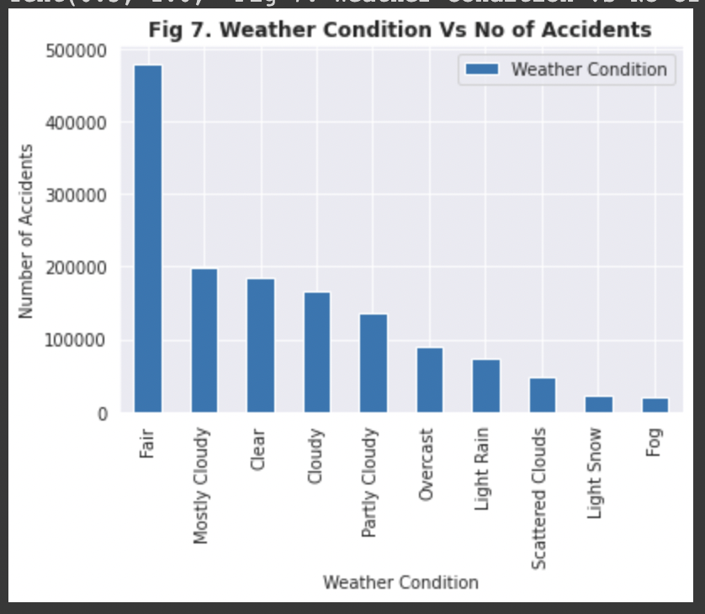
During which weather condition was the number of accidents the highest?
The weather condition for most of the accidents was clear, followed by overcast and mostly cloudy. Overcast and mostly cloudy are reasonable factors for accidents unlike clear, which means that weather conditions also do not play an important role.
METHOD AND LOGIC BEHIND THE CODE :
Method 1: We have used "data.columnname.value_counts()[:10].plot(kind = 'bar')"to get the value counts of each unique value in the column and plot a bar graph showing first 10 highest occurring values.
TYPE OF PLOT :
.plot.bar() from the matplotlib library

Slide 35
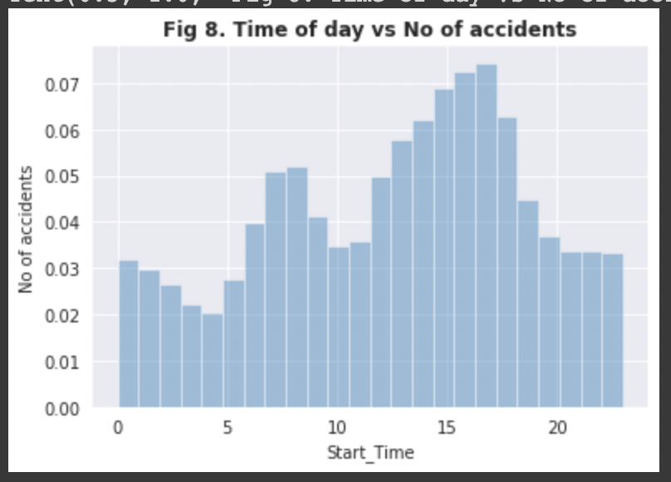
What time of the day are the accidents most likely to occur?
There are two peaks in the graph- one in the morning between 6 am to 9 am and another between 3 pm and 6 pm. This is consistent with the assumption that rush hours in the morning and evening could lead to more accidents.
METHOD AND LOGIC BEHIND THE CODE :
To get the most frequent time when the accidents happen, we have used Method 3 where we plotted the data from the 'Start_Time' column by extracting the hour of the day with the help of the in-built function .dt.hour.
TYPE OF PLOT :
.distplot() from the matplotlib library

Slide 36
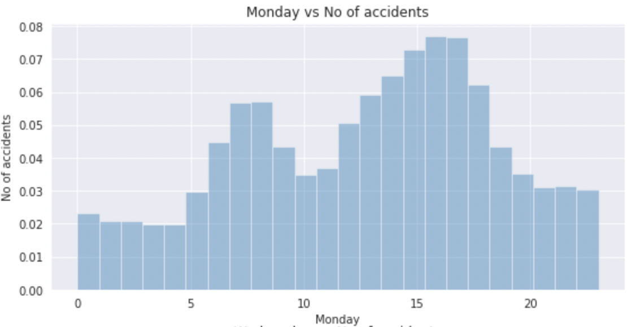
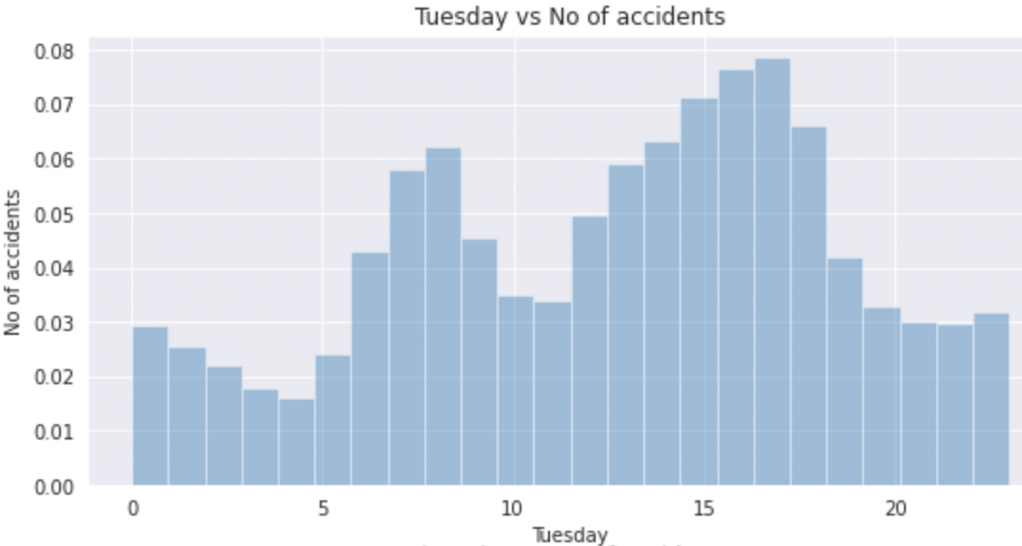
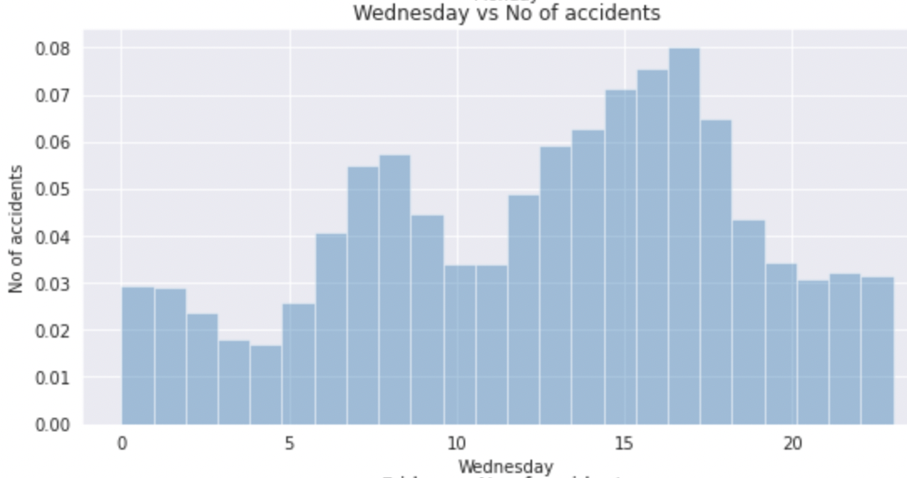
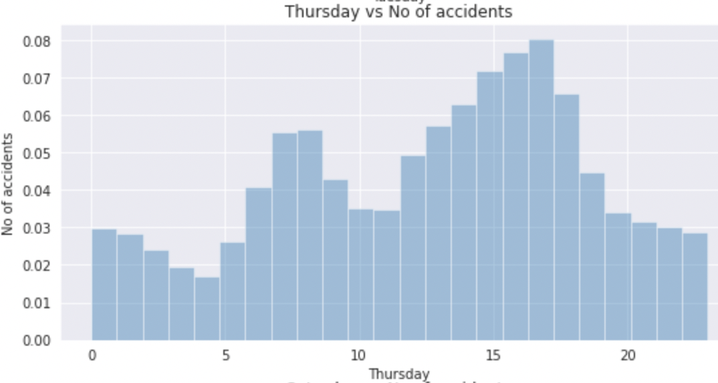
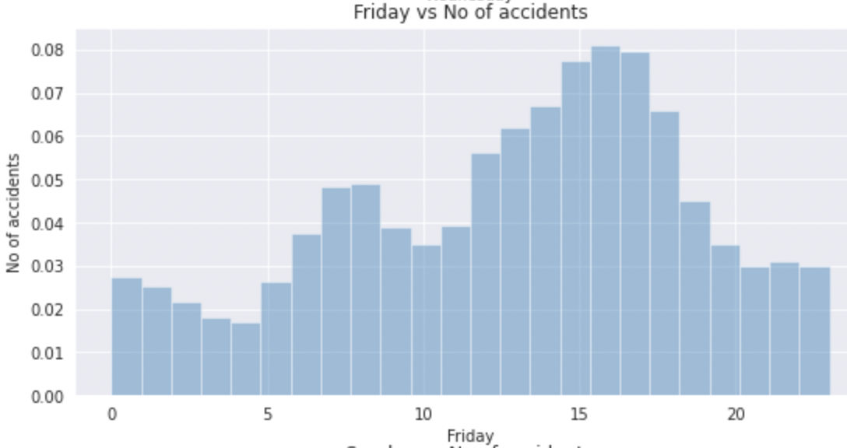
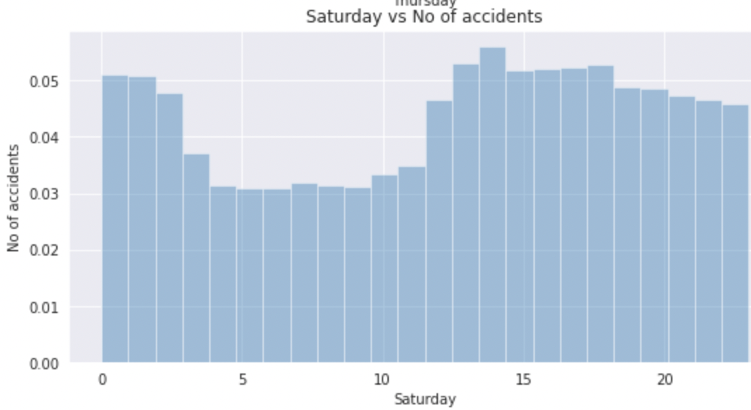
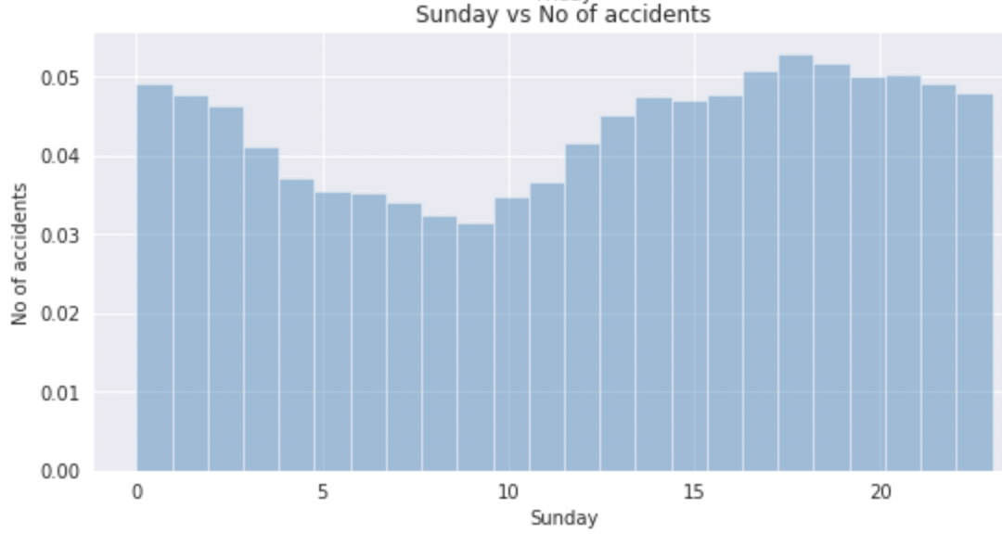
On which day do the accidents occur the most?
While Weekdays follow the general 24-hour pattern- two peaks are coinciding with work rush hours; the distribution for weekend sees a peak between 10 am and 2 pm. This could be due to people going out for leisurely activities on Sundays.
METHOD AND LOGIC BEHIND THE CODE :
We have used method 4 where we have extracted the day of the week and have created new dataframes for each day and have plotted the data in the form of the distplot.
TYPE OF PLOT :
.distplot() from the seaborn library

Slide 37
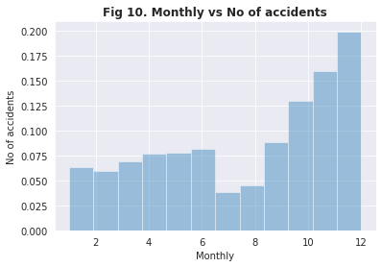
What is the monthly distribution of accidents?
METHOD AND LOGIC BEHIND THE CODE :
To get the monthly distribution of accidents we have used Method 4 where we plotted the data from the 'Start_Time' column by extracting the day of the week with the help of the in-built function .dt.dayofweek == n where n is equal to 0,1,2,3,4,5,6.
TYPE OF PLOT :
.distplot() from the seaborn library
This dip in 7 and 8th month could possibly be due to summer break and then the new school term around August-September.

Slide 38
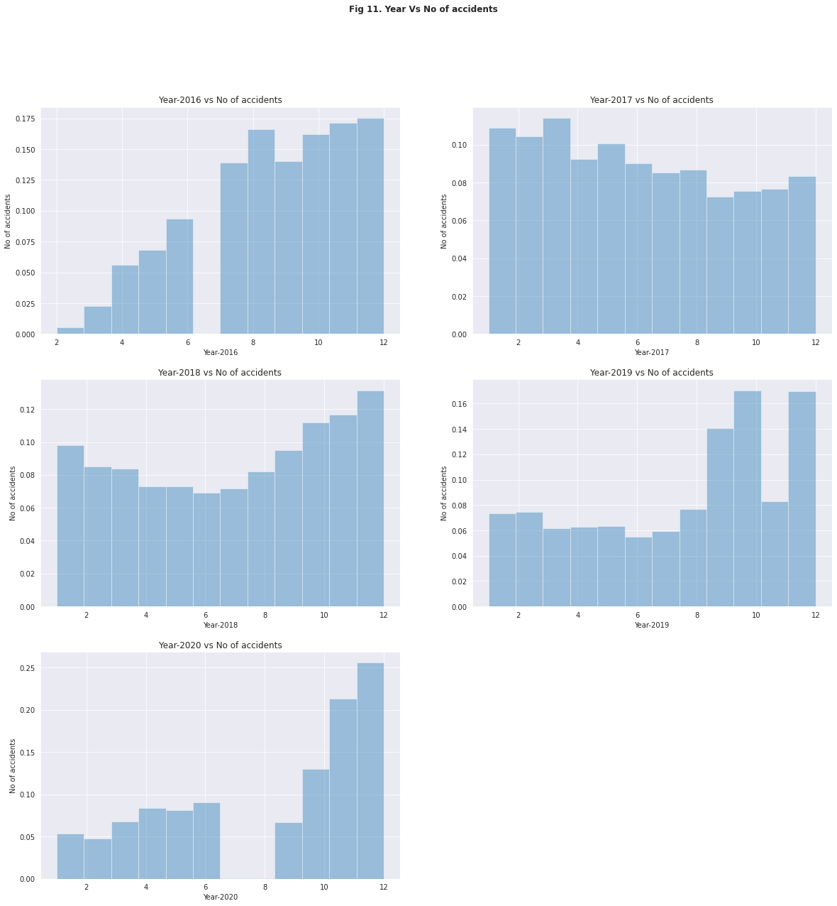
What is the trend of the number of accidents through 2016-2020?
Clearly, there is data missing for the month of January (data was collected from February 2016) and July
During each year, the distribution of the number of accidents over the year could not be noted as a similar pattern but have decreased consistently in the months of June and July
METHOD AND LOGIC BEHIND THE CODE :
To get the yearly distribution of accidents we have used Method 4 where we plotted the data from the 'Start_Time' column by extracting the month of the year and grouping them by year with the help of the in-built function .dt.month
TYPE OF PLOT :
.distplot() from the seaborn library

Slide 39
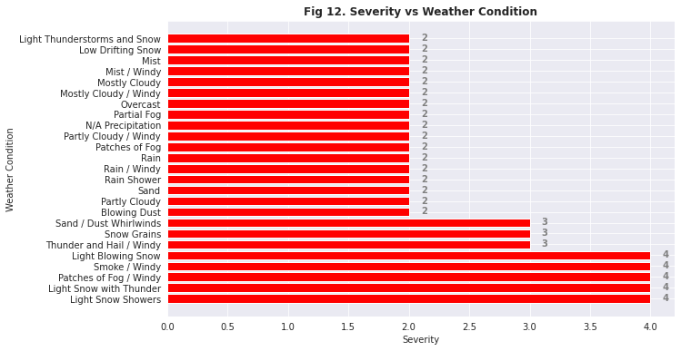
Under each weather condition, which level of severity was seen to have recorded the highest number of accidents?
So, it is seen the weather conditions like Snow, smoke and windy has seen high severe accidents. This is in line with logical thinking that such extreme weather conditions are likely to have caused severe accidents
METHOD AND LOGIC BEHIND THE CODE :
Method 5: We have grouped the data by Weather Condition and Severity. We have further calculated number of accidents in each Severity in particular Weather Condition by using .size(). Then again grouped by Weather Condition using groupby(level=0) to deal with multilevel index and then used .idxmax() to get Severity with maximum number of accidents in each Weather Condition.
TYPE OF PLOT :
.plot.barh() from the matplotlib library

Slide 40
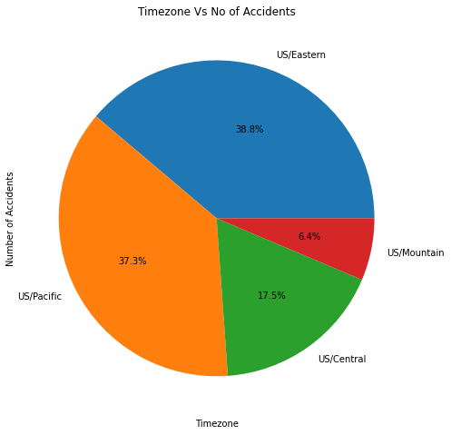
What is the time-zone to see highest number of accidents?
The US/Eastern Time-zone saw the highest number of accidents with 38.8% of the data being recorded in this timezone.
METHOD AND LOGIC BEHIND THE CODE :
To get the highest number of accidents under each time-zone we have used method 1 where we plotted a bar graph after grouping the data by time-zone.
TYPE OF PLOT :
.plot.bar() from the matplotlib library

Slide 41
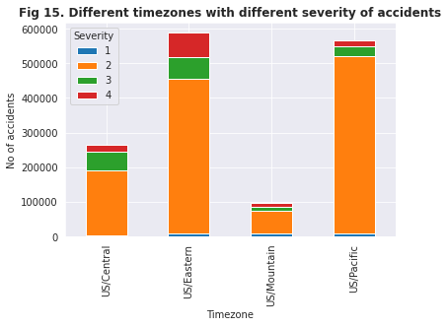
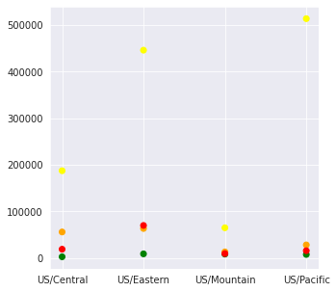
Plotting different time-zones with number of accidents in different level of severity
Under each time-zone, which level of severity was seen to have highest number of accidents?
METHOD AND LOGIC BEHIND THE CODE :
To get the level of severity which had recorded the highest number of accidents under each time-zone we have used method 2 where we plotted a bar graph after grouping the data by time-zone and then by severity and using the in-built function .unstack().
TYPE OF PLOT :
.plot.bar() and .scatter() from the matplotlib library
From this graph, as the data suggests we can see the number of accidents is the highest in level 2 severity

Slide 42
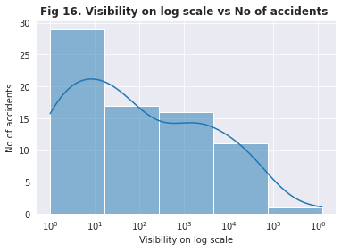
Which visibility range sees the highest number of accidents?
Majority of accidents happened when the visibility was between 1 to 10 miles. Typically, 10-mile visibility is used as a rule of thumb as a person should be able “to see and identify” in the daytime “a prominent dark object against the sky at the horizon” and at night “a known, preferably unfocused, moderately intense light source” that’s 10 miles away. There’s no definition of how tall the “prominent dark object” or the “light source” can be. On the surface of things, visibility is not a strong enough reason for the accidents.
METHOD AND LOGIC BEHIND THE CODE :
To get the visibility range where the number of accidents was the most, we have used Method 1 where we plotted the value counts of the column 'Visibility' on a histplot.
TYPE OF PLOT :
.histplot() from the seaborn library

Slide 43
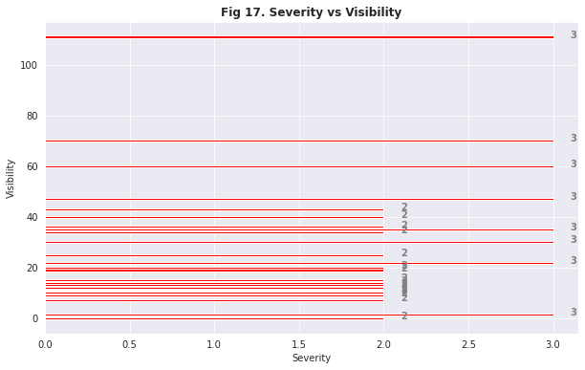
Under different Visibility range, which level of severity of accident records the highest number of accidents?
METHOD AND LOGIC BEHIND THE CODE :
To get the level of severity which had recorded the highest number of accidents under each visibility we have used method 2 where we plotted a bar graph after grouping the data by visibility and then by severity.
TYPE OF PLOT :
.plot.barh() from the matplotlib library
It is observed that below 40 mi, mostly accidents occurred with severity 2. But above 40 mi, we observed accidents of high severity of level 3. Which is logically correct, as when visibility range increases it is likely to observe severe accidents.

Slide 44
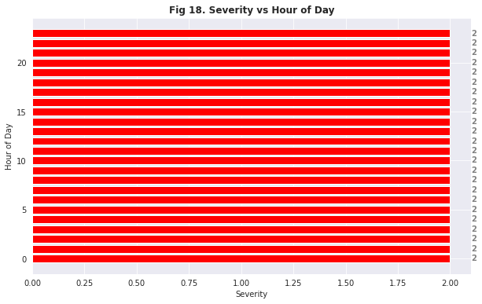
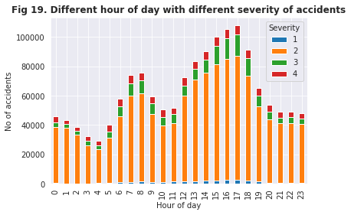
Which level of severity was recorded the most in each hour of the day?
METHOD AND LOGIC BEHIND THE CODE :
For fig 19, to get the level of severity which had recorded the highest number of accidents during each hour of the day we have used method 2 where we plotted a bar graph after grouping the data by hour of the day with the help of the in-built function .dt.hour() and then by severity and using the in-built function .unstack(). We have also used method 5 to get fig 18.
TYPE OF PLOT :
.plot.bar() from the matplotlib library
So, most of the accidents that have occurred during night are of severity 2.

Slide 45
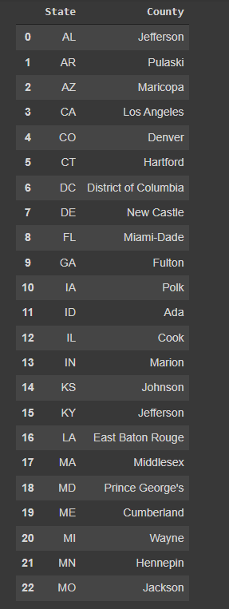
In each state, which county has recorded the highest number of accidents?
METHOD AND LOGIC BEHIND THE CODE :
Method 5: We have grouped the data by State and County. We have further calculated number of accidents in each County in particular state by using .size(). Then again grouped by State using groupby(level=0) to deal with multilevel index and then used .idxmax() to get county with maximum number of accidents in each state.
TYPE OF PLOT :
.plot.barh() from the matplotlib library
The table shows the states and respective Counties which have recorded the highest number of accidents.

Slide 46

Data Modelling

Slide 47
Preparing data for modelling
We have assumed that the Severity of the accident to be the target variable as it the parameters in the dataset effect the severity directly
In the whole dataset, we take only those columns that directly affect the level of severity of a given accident
The columns that have been taken into consideration are: 'County', 'City', 'State' ,'Timezone', 'Temperature(F)', 'Humidity(%)', 'Pressure(in)', 'Visibility(mi)', 'Wind_Direction', 'Wind_Speed(mph)', 'Weather_Condition', 'Location', 'Severity'
Now, we will perform label encoding on the columns that contain categorical values to convert them into integers which will help us in finding the best fit algorithm to predict the severity of each accident

Slide 48
Splitting our data into Train and Test
We will split our data into two sets -
Training set : The data that will be used to train our model and understand the parameters
Testing set: The data on which we will use our model to test the performance of our model
We will be using the train_test_split function from the sklearn.model_selection library to help us in splitting in data
We will split 70% of the data as our training data and 30% of the data as the testing data

Slide 49
Standardization and Model Fitting
We have observed that the data contains columns with values under 10 and also columns that have values greater than 4500. So, we will be standardizing all the values with the help of the function StandardScaler from the sklearn.preprocessing library
After standardizing the values, we will now fit the Linear regression model from the sklearn library on our dataset
After fitting the model, we will now check the accuracy of our model by comparing the values that have been generated by our model and the values in our dataset with the help of the function .score()

Slide 50
ACCURACY OF THE MODEL
We have observed that the accuracy of the linear regression model is just above 4%. We have cross checked the accuracy with another function that the sklearn library provides which is the R square score
We have observed that the accuracy by this score is also the same
Because the linear regression model is not yielding a good percentage of accuracy, we will fit the Random Forest Regressor model to our dataset and compare the accuracy to the linear regression model which is also available from the sklearn library.
As we can see that the accuracy is obtained by the RandomForestRegressor() model is 32.04% which is significantly greater than the LinearRegression() model, we can conclude that the Random Forest Regressor is the best-fit algorithm out of the two models we have used

Slide 51

Conclusion
By understanding the data in the project, by applying different methods and functions in python to evaluate various aspects, and by deriving insights from meaningful graphs, we have been able to conclude that predicting the severity of any given accident requires a lot of parameters to be taken into consideration which have been inferred from the data cleaning and visualization processes . Some of them being:
Visibility(mi) - whether the visibility falls under critical range.
Weather_condition – whether the condition is fair or cloudy or snowy.
Timezone & County – what is the trend of accidents in a particular time zone in the given county and many more.
We will predict the severity of a particular accident once we have the required data using the best-fit algorithm according to our analysis which is the Random Forest Regressor.

Slide 52


FUTURE SCOPE OF THE PROJECT
We were able to successfully implement our findings and models to the data set for the number of accidents in the United States of America. Like we have concluded, we were able to find the related factors and draw insightful inferences.
As a part of future scope of our project, we can consider other models and methods such as feature scaling, correlation matrix, one hot encoding to generate more meaningful insights.
In future, we can also implement similar analysis on different countries of the world. We can use similar data for different countries and draw conclusions based on the demographics of that region. These conclusions would be of help to the concerned authorities, who would be able to take the right measures and save many lives across the globe.

Slide 53

REFERENCES
https://www.kaggle.com/sobhanmoosavi/us-accidents
https://melbournedrivinglesson.blogspot.com/2020/04/complete-your-goal-of-driving-by.html
http://wilmingtonjournal.com/heroic-police-officer-risks-life-to-save-injured-young-driver-who-rolled-off-road/
This Photo by Unknown author is licensed under CC BY-SA-NC.

Slide 54


